Slide 1

AIM OF THE EXPERIMENT Design and Implementation of a 16 bit Program Counter
DEFINITION
The Program Counter and its associated circuitry form a crucial part of a microprocessor.
For a microprocessor to load and execute an instruction, it first needs to fetch the instruction from the memory.
To do so, there has to be a register in the microprocessor which stores the memory address of the next instruction to be fetched. That register is the Program Counter (PC).

Slide 2
Assembly program example
To move a block of four 8 bit numbers from loc I (11,22,33,44)to loc
Memory Block
I | 11
I+1 | 22
I+2 | 33
I+3 | 44
Memory address | Program
1000 | MOVE COUNT,4
1004 | MOVE A,[I]
1008 | MOVE [J],A
100C | INC I
1010 | INC J
1014 | BACK:DEC COUNT
1018 | Jump if not zero,BACK
101C | STOP
Memory Block
J
J+1
J+2
J+3

Slide 3
WORKING OF THE PROGRAM COUNTER
Typically, the microprocessor fetches and executes instructions sequentially.
So after fetching an instruction from an address, the instruction from the next consecutive address is fetched and so on.
But occasionally, there can be jumps---the next instruction to be fetched and executed may be several instructions ahead or behind the current instruction.
Likewise, the circuitry associated with the PC registers needs to support two operations:
(1) increment the PC contents by one,
(2) add/subtract given value to PC contents.

Slide 4
WORKING OF THE PROGRAM COUNTER
The PC register is of length 16-bits.
After the reset signal is applied, its contents should be zero.
Considering the PC module as a black box, it has the following inputs: clk, reset, inc, add, sub, offset of which only offset is a wire vector of length 16.
The only output of pc is a 16-bit wire vector of PC register contents.
The increment and add/subtract operations each take one clock cycle, so one or add/subtract operation can be performed every clock.

Slide 5
WORKING OF THE PROGRAM COUNTER
Depending upon the inputs received in the current clock cycle, the increment or add/subtract can be performed and made available at the inputs to the PC register in the current clock cycle itself.
But the contents of the PC register will change only at the positive clock edge and so the updated register output will be seen only in the next clock cycle but during which the next operation can be computed.
In this way one operation can be performed every clock cycle.

Slide 6
WORKING OF THE PROGRAM COUNTER
When inc is high, the increment operation is to be performed.
The add, sub, offset inputs are ignored and the contents of the PC register are simply incremented by one.
When add or sub is high, the add or subtract operation respectively is performed, during which the value offset is added to or subtract from the PC register contents, and the result is stored back in the PC register.
When inc, add and sub are all low, PC register value remains unchanged. It is guaranteed that at most one of inc, add or sub will be high in a clock cycle.

Slide 7
WORKING OF THE PROGRAM COUNTER
Depending upon the inputs received in the current clock cycle, the increment or add/subtract can be performed
It can be made available at the inputs to the PC register in
the current clock cycle itself.
But the contents of the PC register will change only at the positive clock edge
Hence the updated register output will be seen only in the next clock cycle but during which the next operation can be computed.
In this way one operation can be performed every clock cycle.

Slide 8
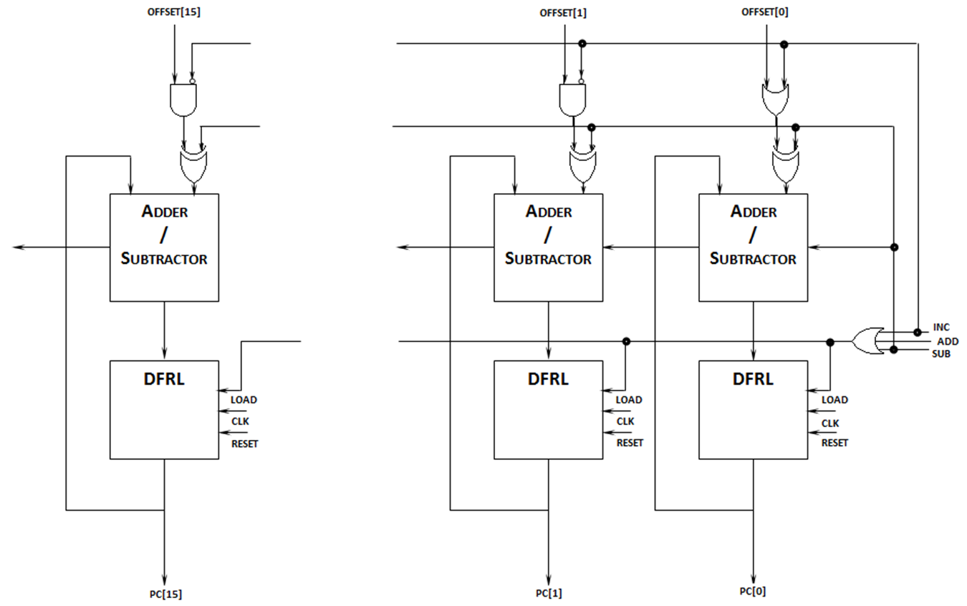
16 BIT PROGRAM COUNTER

Slide 9
pc.v Module 1
module fa (input wire i0, i1, cin, output wire sum, cout);
wire t0, t1, t2;
xor3 _i0 (--------------------);
and2 _i1 (----------------------);
and2 _i2 (-----------------------);
and2 _i3 (------------------);
or3 _i4 (--------------------);
endmodule

Slide 10
pc.v Module 2
module addsub (input wire addsub, i0, i1, cin, output wire sumdiff, cout);
wire t;
fa _i0 (--------------------);
xor2 _i1 (--------------------);
endmodule

Slide 11
pc.v Module 3
module pc_slice (input wire clk, reset, cin, load, inc, sub, offset, output wire cout, pc);
wire in, inc_;
invert invert_0 (-------------);
and2 and2_0 (-----------------);
addsub addsub_0 (sub, pc, t, cin, in, cout);
dfrl dfrl_0 (------------------------);
endmodule

Slide 12
pc.v Module 4
module pc_slice0 (input wire clk, reset, cin, load, inc, sub, offset, output wire cout, pc);
wire in;
or2 or2_0 ( );
addsub addsub_0 ( );
dfrl dfrl_0 ( );
endmodule

Slide 13
pc.v Module 5
module pc (input wire clk, reset, inc, add, sub, input wire [15:0] offset,
output wire [15:0] pc);
input wire load;
input wire [15:0] c;
or3 or3_0 ( );
pc_slice0 pc_slice_0 ()
pc_slice pc_slice_1 ()
-----------------------------------------------------------------------------------------------
-----------------------------------------------------------------------------------------------
pc_slice pc_slice_15 ()
endmodule

Slide 14
DESIGN AND SIMULATION
iverilog -o test_pc lib.v pc.v tb_pc.v
vvp test_pc
The pc module can be tested using the supplied tb_pc.v with the commands to simulate:
You can use the lib.v supplied for basic components.
Waveform observation with the command:
gtkwave tb_pc.vcd

Slide 15
OUTPUT TABLE
 | inc | add | sub | offset [15:0] | output
 | Bit 18 | Bit 17 | Bit 16 | Bit 15 to Bit0 | pc[15:0]
CASE 1 | 1 | 0 | 0 | XXXX | 0001
CASE 2 | 0 | 1 | 0 | 00A5 | 00A6
CASE 3 | 0 | 0 | 0 | XXXX | 00A6
CASE 4 | 1 | 0 | 0 | XXXX | 00A7
CASE 5 | 0 | 0 | 1 | 0014 | pc-offset =00A7-0014 =0093

Slide 16
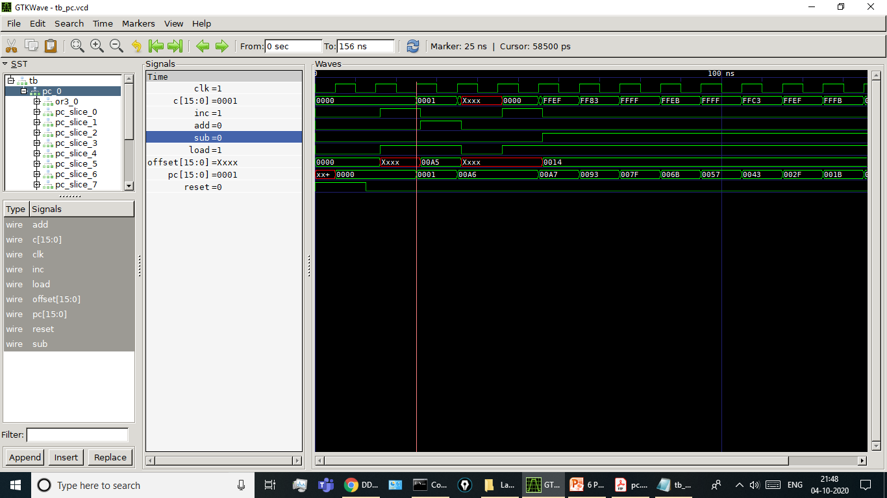
 | inc | add | sub | offset [15:0] | output
 | Bit 18 | Bit 17 | Bit 16 | Bit 15 to Bit0 | pc[15:0]
CASE 1 | 1 | 0 | 0 | XXXX | 0001

Slide 17

 | inc | add | sub | offset [15:0] | output
 | Bit 18 | Bit 17 | Bit 16 | Bit 15 to Bit0 | pc[15:0]
CASE 2 | 0 | 1 | 0 | 00A5 | 00A6

Slide 18

 | inc | add | sub | offset [15:0] | output
 | Bit 18 | Bit 17 | Bit 16 | Bit 15 to Bit0 | pc[15:0]
CASE 3 | 0 | 0 | 0 | XXXX | 00A6

Slide 19

 | inc | add | sub | offset [15:0] | output
 | Bit 18 | Bit 17 | Bit 16 | Bit 15 to Bit0 | pc[15:0]
CASE 4 | 1 | 0 | 0 | XXXX | 00A7

Slide 20

 | inc | add | sub | offset [15:0] | output
 | Bit 18 | Bit 17 | Bit 16 | Bit 15 to Bit0 | pc[15:0]
CASE 5 | 0 | 0 | 1 | 0014 | 0093

